Slide 1
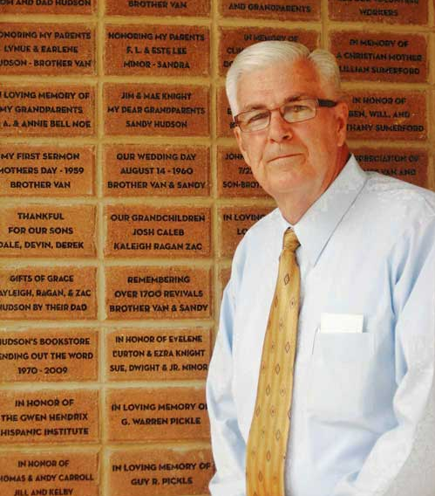
FUNDRAISING with POLAR ENGRAVING

Slide 2
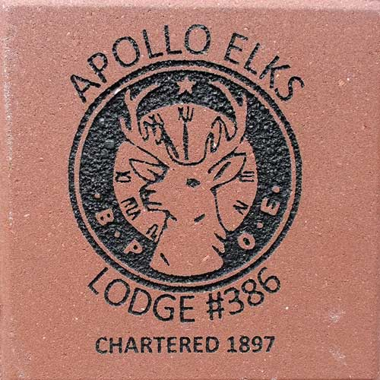
WHY A BRICK OR TILE FUNDRAISER?
Large profit margins.
No upfront cost required to get started.
People enjoy and want to see their own personal messages engraved forever.
Large range of donation amounts from $50 to $1,000’s of dollars.

Slide 3
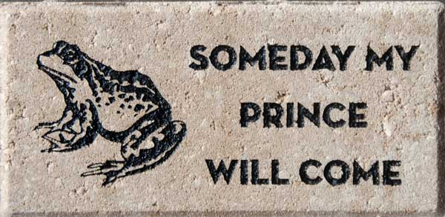
WHO & WHERE ARE YOUR DONORS?
Donors could be ANYONE!
Members of your organizations and everybody that wants to support your project such as schools, churches, fire departments, police, Veterans associations, etc.
Local businesses such as banks or your vendors. Don’t forget we can engrave their logos!

Slide 4
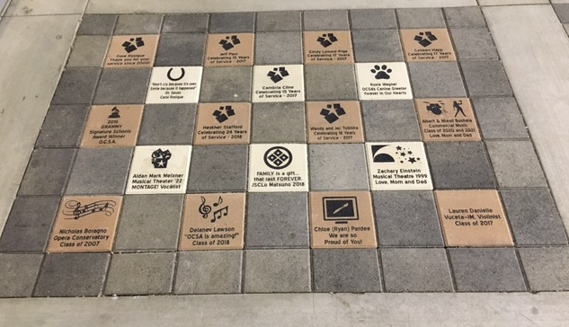
WHERE TO DISPLAY BRICKS/TILES?
If you’re using bricks: walkways, entryways, gardens, patios, under trees, planters, surrounding statues or foundations are all great locations to place them.
Do you have a wall? You can also use engraved tiles! Donor walls can have either vertical bricks or tiles both inside or outside of buildings.

Slide 5
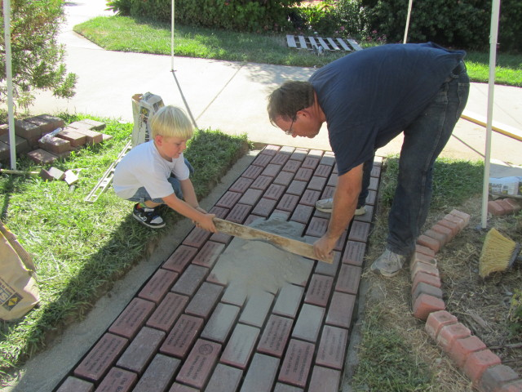
WHO PLACES THE BRICKS/TILES?
We recommend using a local professional to install your bricks or tiles. They know your area and can recommend the best way to do it.
Our bricks and tiles are standard U.S. sizes and are easy to install.

Slide 6
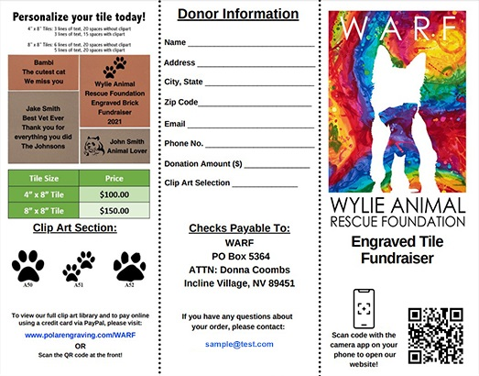
HOW TO APPROACH POTENTIAL DONORS?
Take advantage of Polar Engraving’s FREE Donor Website and Brochure design services.

Slide 7
POTENTIAL FUNDRAISER PROFITABILITY
100 4”x 8” Bricks sold @ $100 each = $10,000
Your cost is $19.50 x 100 = $1,950
Total profit generate = $8,050
100 8”x 8” Bricks sold @ $350 each = $35,000
Your cost is $27.50 x 100 = $2,750
Total profit generated = $32,250
50 12”x 12” Bricks sold @ $750 each = $37,500
Your cost is $48.50 x 50 = $2,425
Total profit generate = $35,075
The examples shown above don’t include other
opportunities to raise additional revenue by offering
bricks with custom clip art or logos or replica tiles.

Slide 8
BUILDING A PARTNERSHIP
Polar Engraving has the knowledge, technology and experience to make your project or fundraiser a huge success.
We want to provide you with the highest quality engravings and the best marketing tools to be successful.
We are always available to answer your questions and assist you.
We are committed to the success of your fundraiser.
Polar Engraving, the company that helps you make money!

Slide 9
POLAR ENGRAVING, THE COMPANY THAT HELPS YOU MAKE MONEY!
Customer service and satisfaction is ALWAYS our #1 priority!
Free Sample: After receiving your free personalized brick or tile sample with your clip art or logo, you can display it to motivate donors and start your campaign.
The ability to utilize our free marketing tools such as the Donor Website and Brochure order forms.
FREE Donor Website Design: Polar Engraving can provide your organization with a free customized website with your text, logo and photos. You will be able to receive and manage online orders from your donors. The donations will flow directly into your own PayPal account or if you prefer, you can accept checks. A customized link will be created specifically for your organization. You can link to your website or place on any advertising materials. It is a hassle-free way to collect and manage orders.

Slide 11
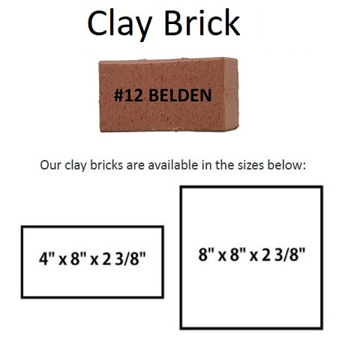
BRICK COLOR CHOICES
Clay or Concrete

Slide 12
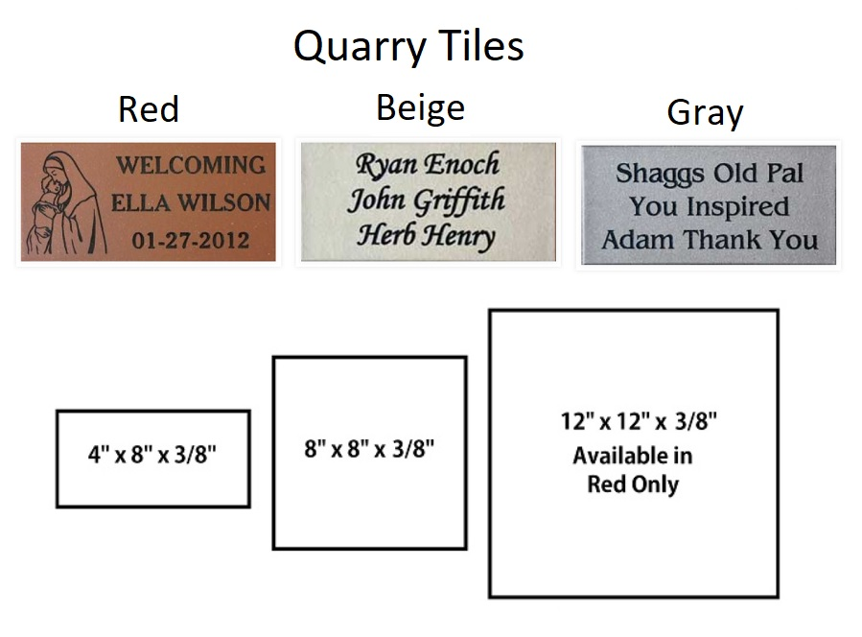
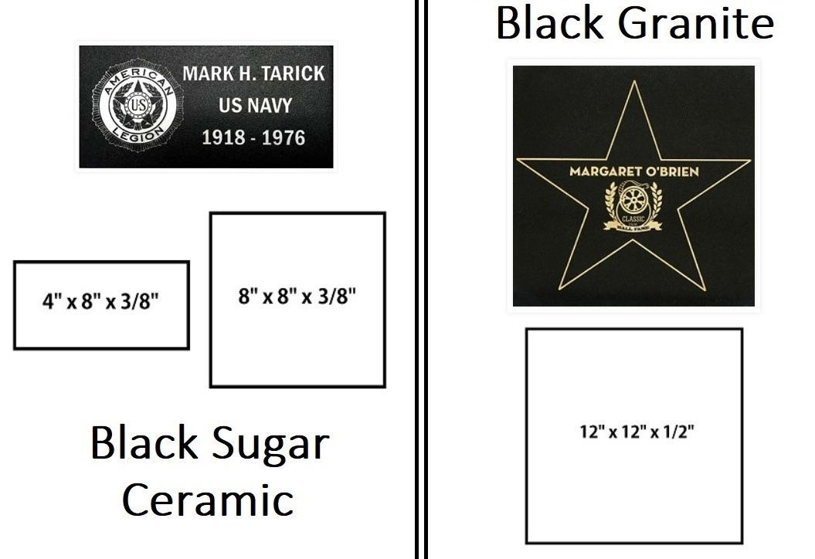
TILE COLOR CHOICES
Black Ceramic Sugar, Black Granite or Quarry

Slide 13
BRICK FUNDRAISING PRICING
Bulk Pricing

Slide 14
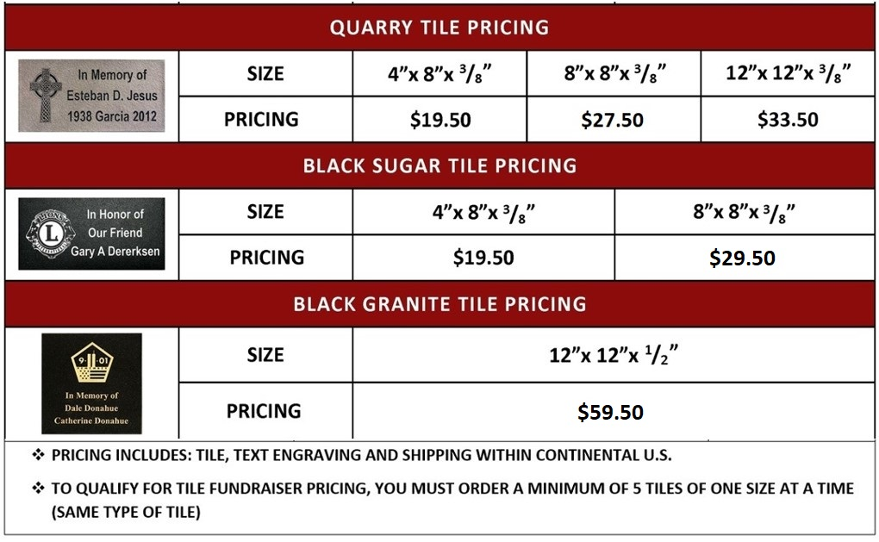
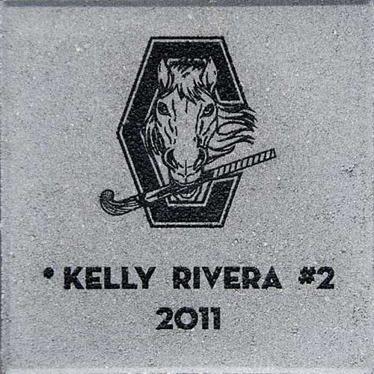
TILE FUNDRAISING PRICING
Bulk Pricing

Slide 15
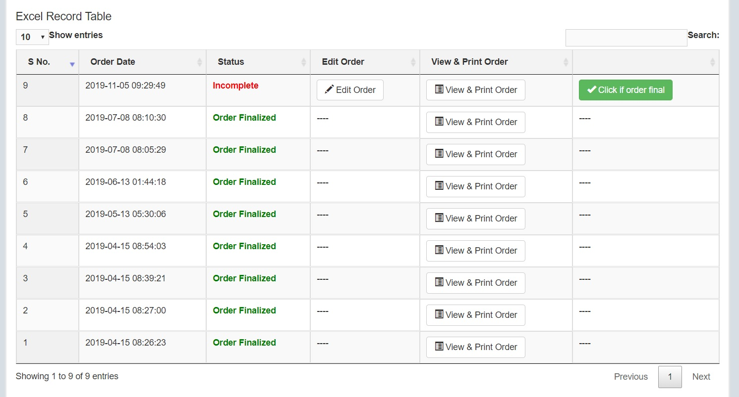
ORDERING YOUR BRICKS
Easy Free Online Ordering System with Donor Website

Slide 16
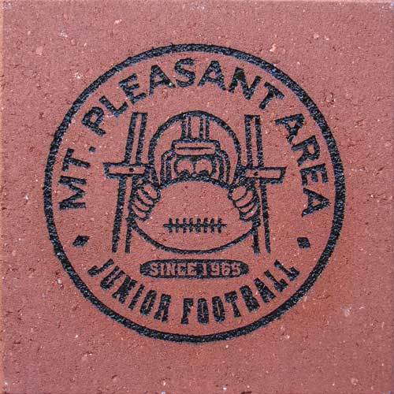
THE POLAR ENGRAVING DIFFERENCE
Top quality engraving and customer service.
The ONLY brick engraving company in the USA officially licensed to engrave military emblems.
Truly FREE shipping (Continental US).
Free engraved brick or tile sample.
Free custom Donor Website and Brochure design.
No minimum order quantities.
We engrave on all types of bricks and tiles; concrete, clay, ceramic, quarry and granite.
We can also engrave on your bricks and tiles.
We can engrave in almost any font or language.
We can engrave any clip art or custom logo for only $6.00 with no set up fees.
Largest clip art library available.
239-597-8005 www.PolarEngraving.com

